Slide 1
Road detection from a simple 2D Camera
Dwight Kerkhove, Tom Vande Wiele, Sarah Merckx, Bavo Huyghe

Slide 2
Road detection from a simple 2D Camera
Project plan
Solution - classifier
Model 1 – Support Vector Machines
Model 2 – Lane detection, texture and clustering classifier
Model comparison
Lane detection, texture and clustering classifier model
Lane detection
Texture classifier
Clustering
Model
Results

Slide 3
Road detection from a simple 2D Camera
Project plan
Goal
Derive maximum speed for each frame
Solution :
Design classifier to distinguish between ‘road’ and ‘no road’
Detect obstacles within mask (avoid collisions)
2 approaches :
Model 1 based on support vector machines
Model 2 based on lane detection, texture classifier and clustering
Comparing models and select best performer

Slide 4
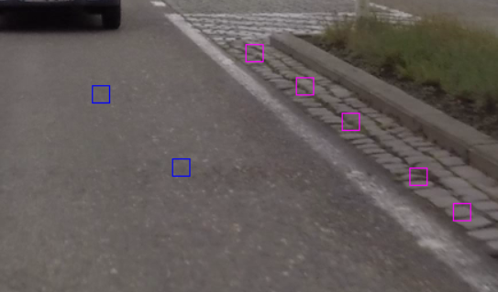
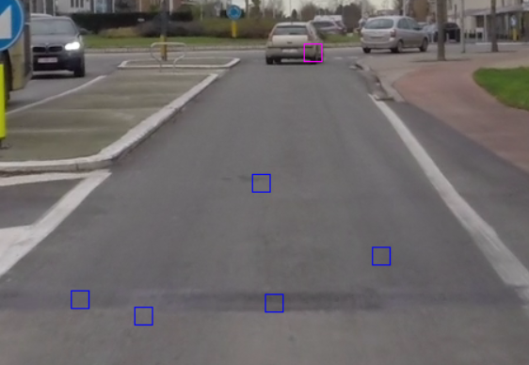
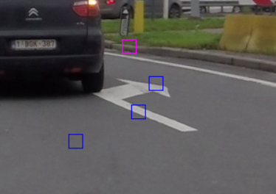
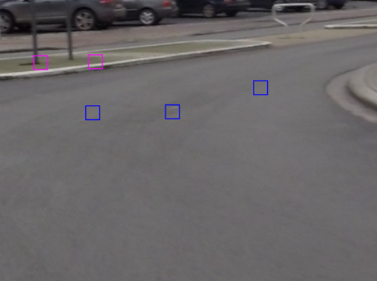
Road detection from a simple 2D Camera
Solution - classifier
Model 1 – Support Vector Machines
Sampling strategy (not random)
Biased towards road marks, road surface changes
Focused on goal

Slide 5
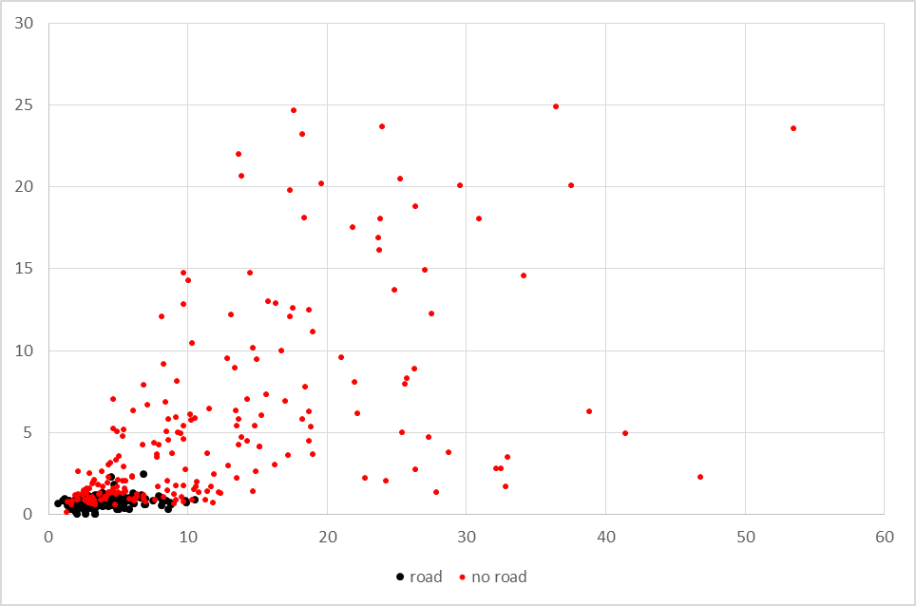
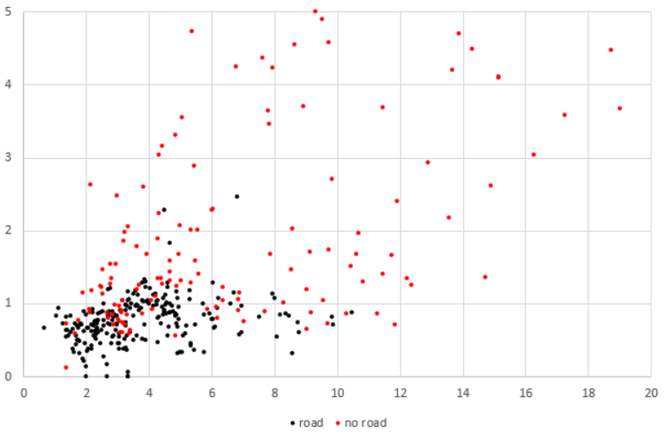
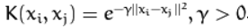
Road detection from a simple 2D Camera
Solution - classifier
Model 1 – Support Vector Machines
Sampling strategy
Model settings
Input data [patch 16x16 pixels]
LBP (threshold 1%, number of bins = 8)
Deviation from gray (mean and standard deviation of absolute difference between RGB)
Model parameters (OpenCV)
Type : C_SVC (C-Support Vector Classification) [C=1]
Kernel : RBF (Radial Basis Function) [gamma=1]

Slide 6
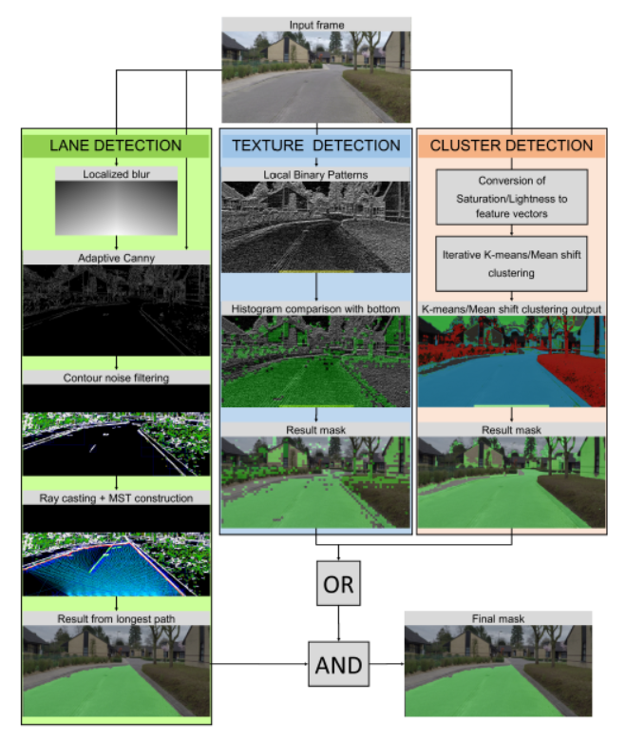
Road detection from a simple 2D Camera
Solution - classifier
Model 2 – based on
Lane detection
Texture detection
Clustering detection

Slide 7
Road detection from a simple 2D Camera
Solution - classifier
Model comparison
F1-score | Model
sample set | lane detection | SVM
1 | 0,824 | 0,796
2 | 0,851 | 0,807
3 | 0,804 | 0,783
Accuracy | Model
sample set | lane detection | SVM
1 | 0,85 | 0,80
2 | 0,87 | 0,79
3 | 0,82 | 0,74
Model | Sample set | TT | TF | FT | FF | samples | FPR
lane detection | 1 | 35 | 15 | 0 | 49 | 99 | 0,000
 | 2 | 37 | 13 | 0 | 50 | 100 | 0,000
 | 3 | 37 | 18 | 0 | 45 | 100 | 0,000
SVM | 1 | 39 | 11 | 9 | 40 | 99 | 0,816
 | 2 | 44 | 6 | 15 | 35 | 100 | 0,700
 | 3 | 47 | 8 | 18 | 27 | 100 | 0,600
Code | Ground truth | Predicted
TT (TrueTrue) | Road | Road
TF (TrueFalse) | Road | No Road
FT (FalseTrue) | No Road | Road
FF (FalseFalse) | No Road | No Road

Slide 8
Lane detection
Goal
Create boundary for other classifiers
How?

Slide 9
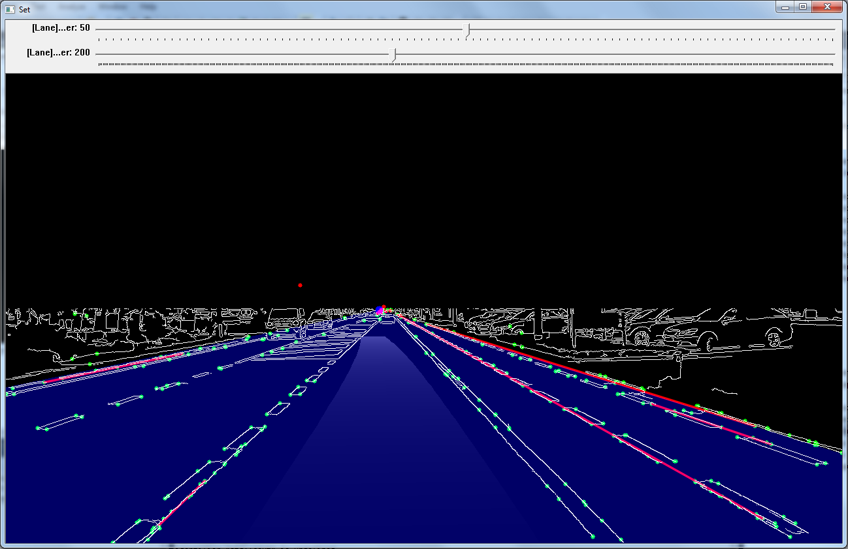
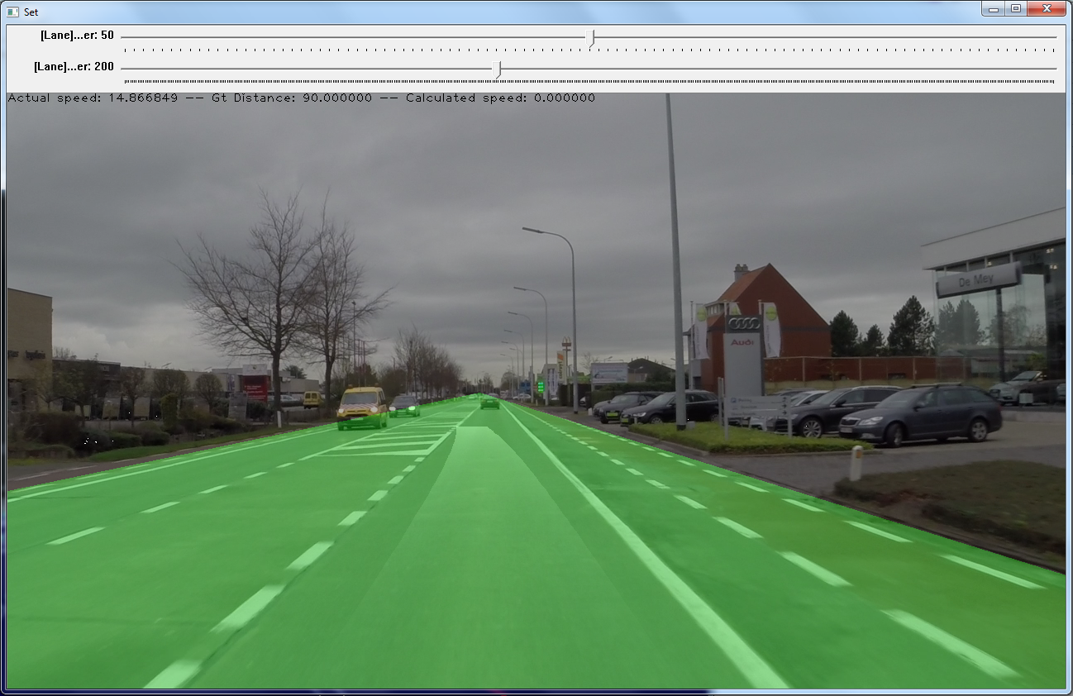
Lane detection – First attempt
Canny edge detection
Hough lines extraction
RANSAC
Determine vanishing point
Fill polygon
Notes:
Canny edge detection
Hough lines extraction
RANSAC on line segments to further refine
Determine vanishing point through resulting segment intersection
Fill triangle area as mask
But what about turns or roundabouts?

Slide 10
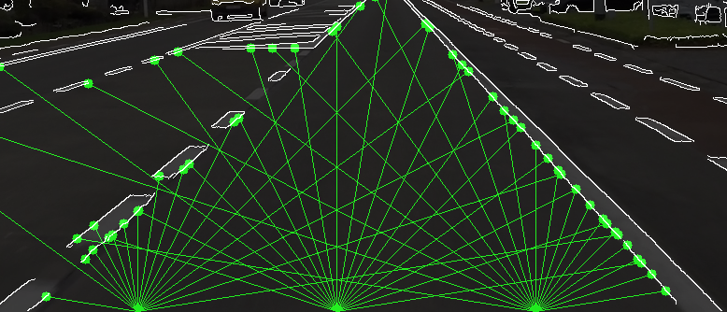
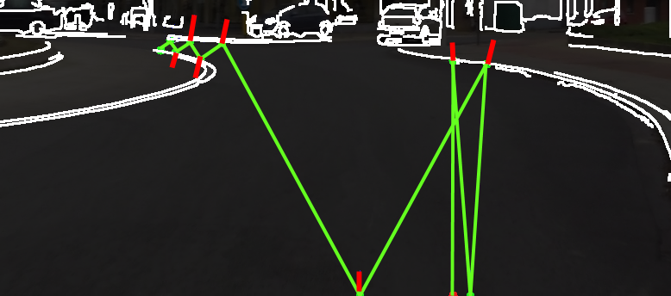
Lane detection – Second attempt
Reachable edges?
Cast rays
Collect hit points
Reflect rays recursively
Notes:
Flood fill algorithm? -> Too many holes in the edges
Which edges are actually reachable?
Shoot rays from bottom area in an arc outward
Determine intersection points with edge pixels (Breshenham line algo.)
Determine normal from edge slopes ($S_{y}/S_{x}$)
Shoot reflection rays recursively to obtain hard to reach areas

Slide 11
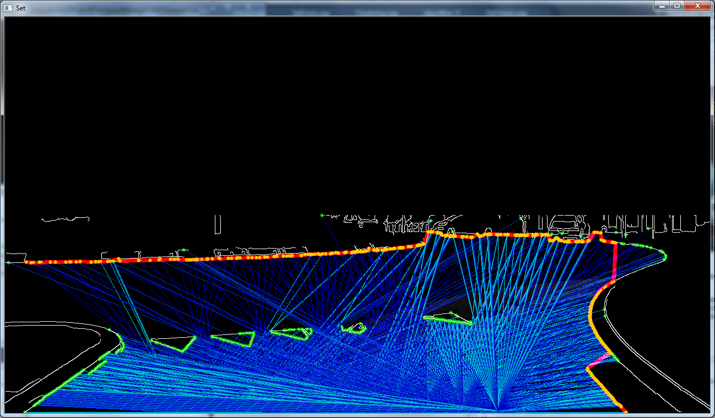
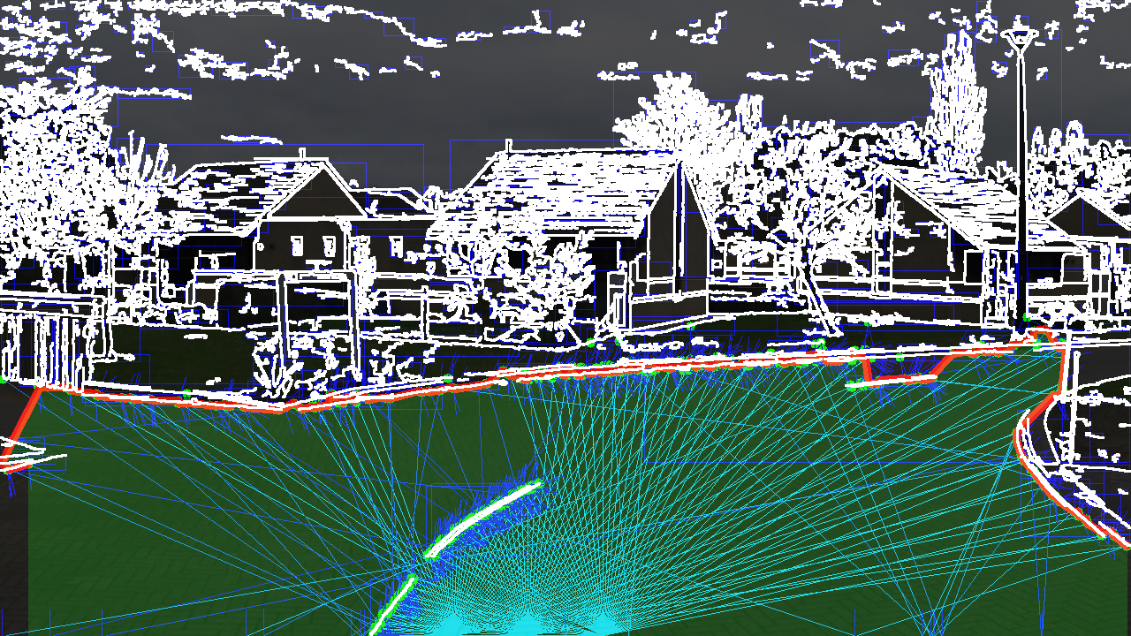
Lane detection – Second attempt
Connect hit points
Build MST
Take deepest path
Fill polygon
Notes:
Play connect-the-dots on the intersection points:
Find the nearest point to the middle bottom as root point
Construct a minimal spanning tree (MST) (Prim’s algorithm)
Take the path to the deepest leaf
Project the start & end points to the bottom row to create a complete mask

Slide 12

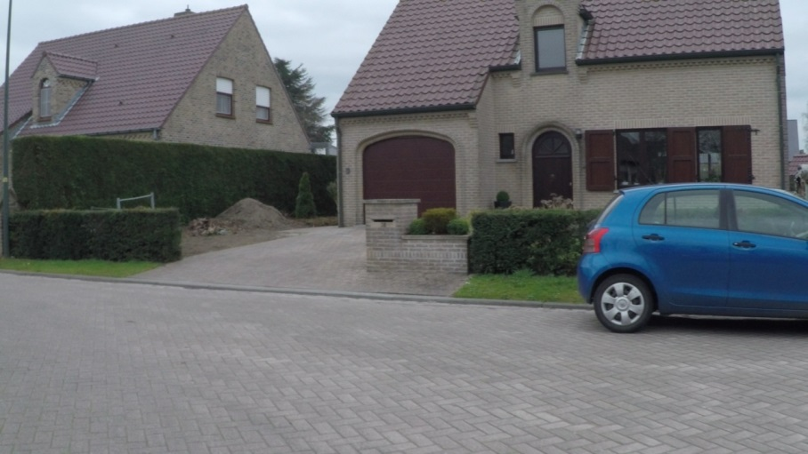
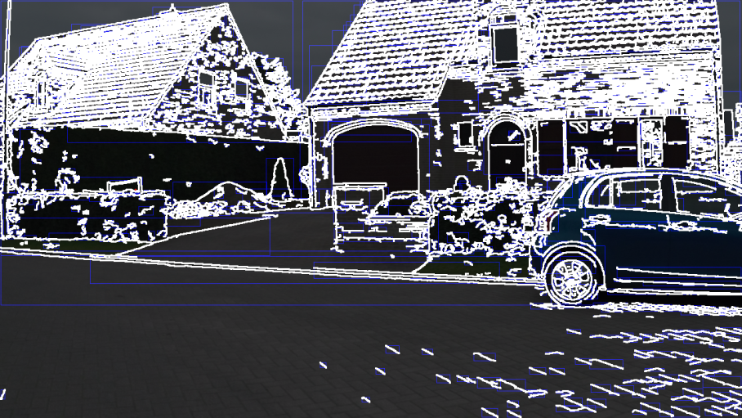
Lane detection – Enhancements
Correct detection of edges is crucial
Reduce dependency with
Localized blur
Adaptive Canny threshold
Notes:
Correct detection of edges is crucial
Attempt to reduce dependency:
Apply localized blur to remove strong edge patterns of the road
Create gaussian blurred image
Linearly interpolate between original and blurred image according to mask
Lower Canny threshold in steps from bottom image upwards
The mask of the localized blur is created by linearly interpolating from the middle vertical to the sides and multiplied by the linear interpolation of the bottom to the top.

Slide 13
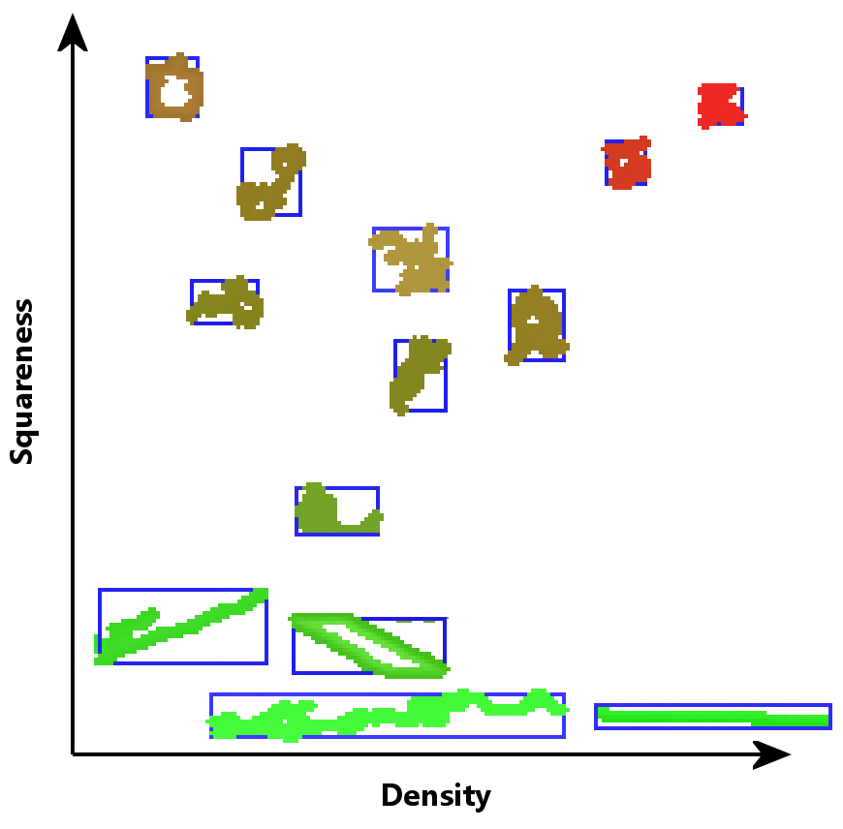
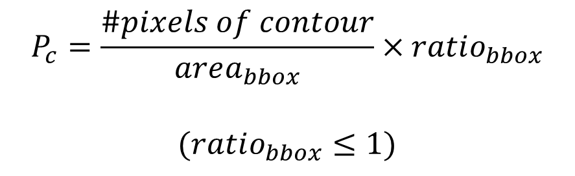
Lane detection – Contour noise suppression
Problem:
Noisy edges
Solution:
Apply filter based on squareness and density
$$P_{c}=\frac{\#pixels of contour}{area_{bbox}}×ratio_{bbox}$$
$$(ratio_{bbox}≤1)$$
Notes:
Low Canny threshold introduces many noisy edges
Solution:
Find contours in edge image
Noisy contours are
Usually near square
Intersect itself into a tangled mess
Measure penalty ($P_{c}$) from squareness and density and remove when threshold is exceeded

Slide 14
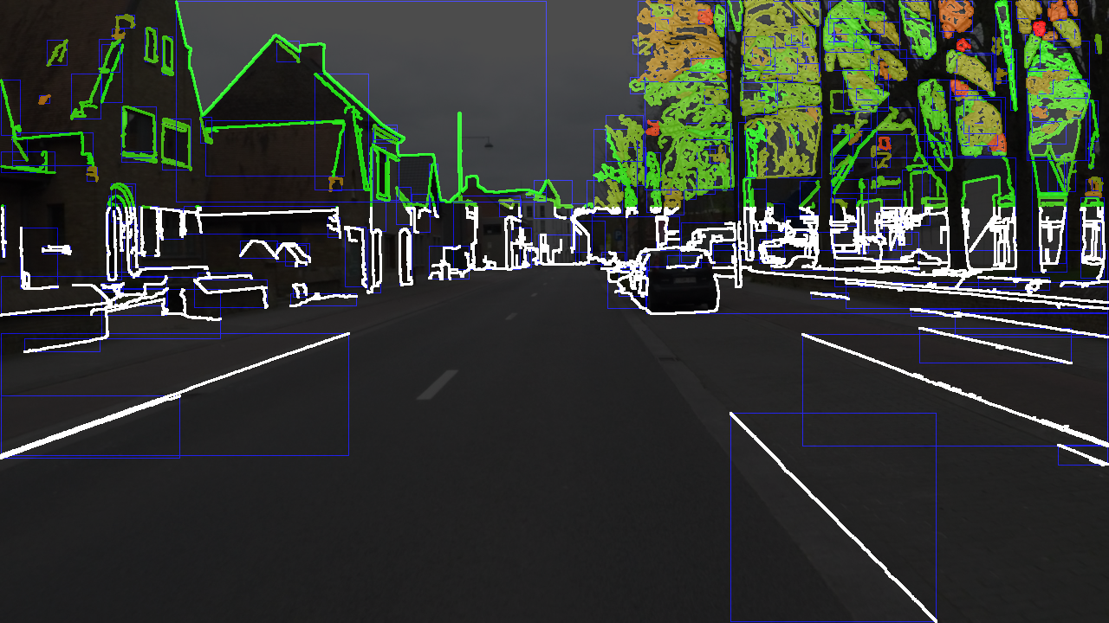
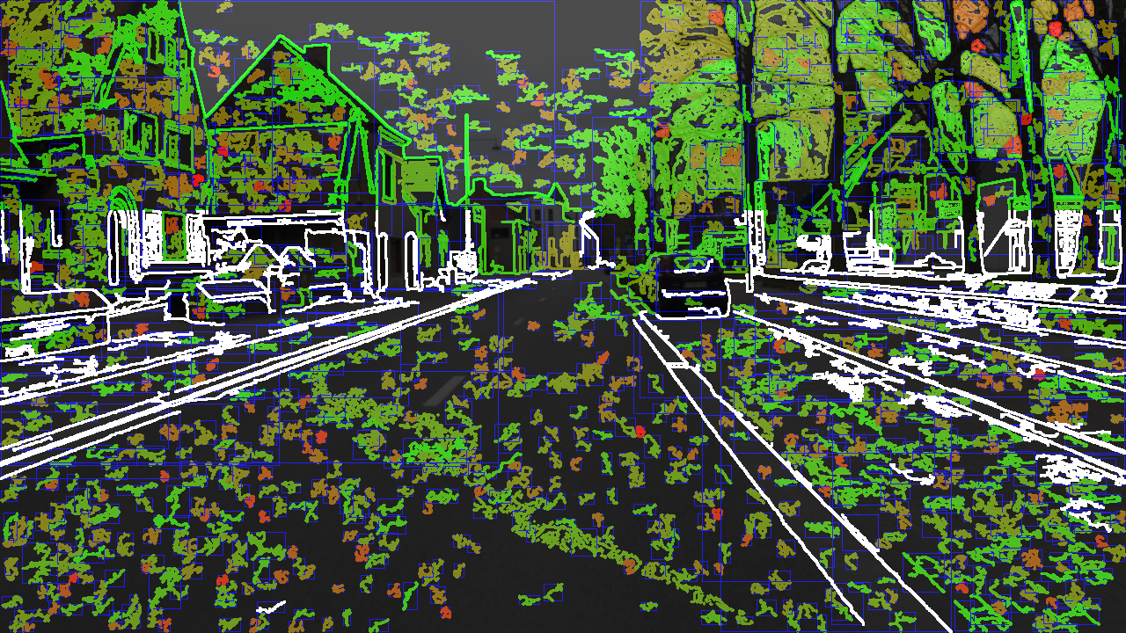
Lane detection – Contour noise suppression
Low Canny threshold
High Canny threshold
Notes:
Lowering the Canny threshold results in a much better detection of the road edges in the distance but introduces a lot of noise. This noise can be filtered out by thresholding the penalty of each contour to a low value.

Slide 15
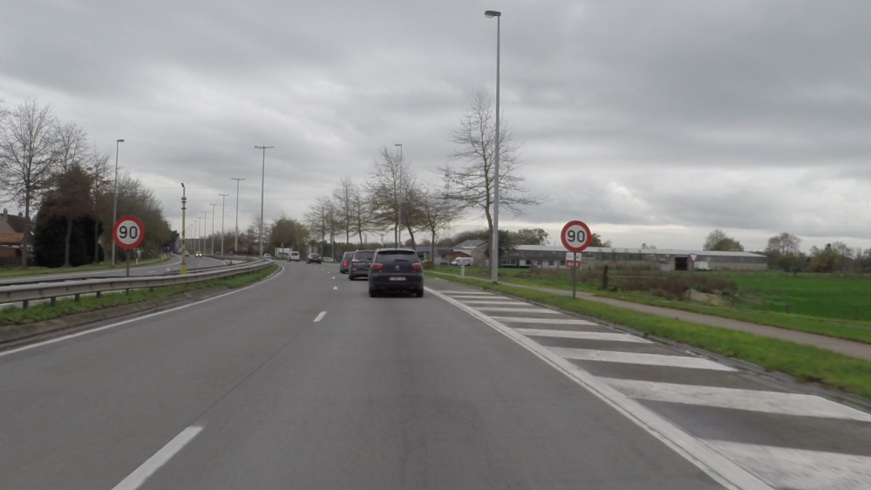
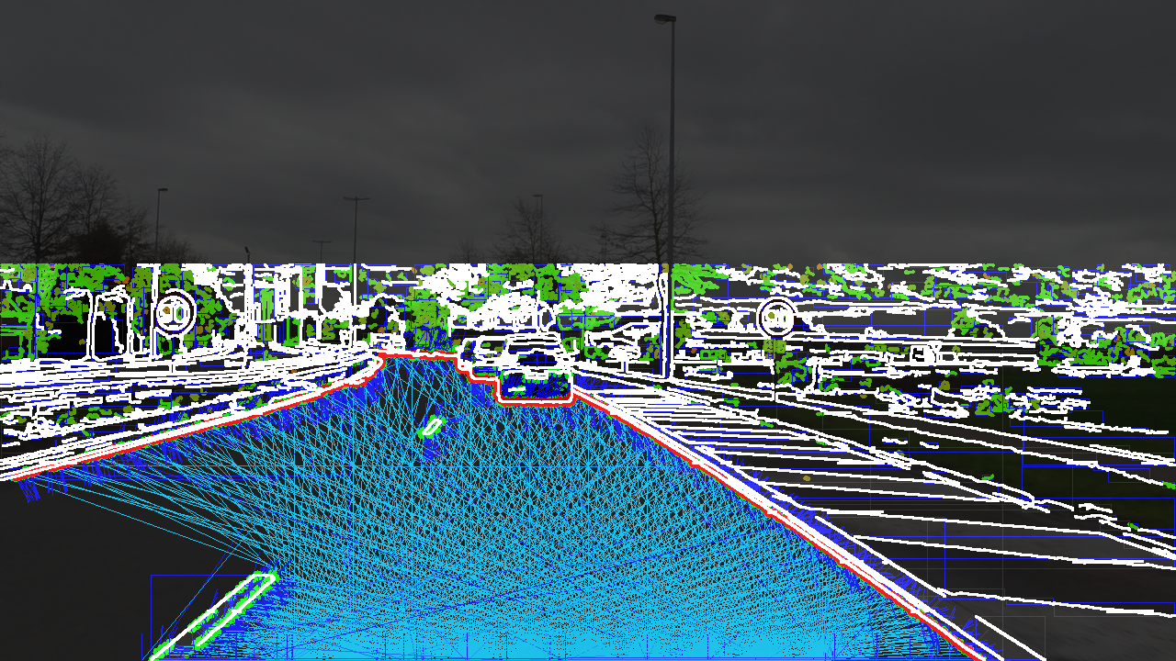
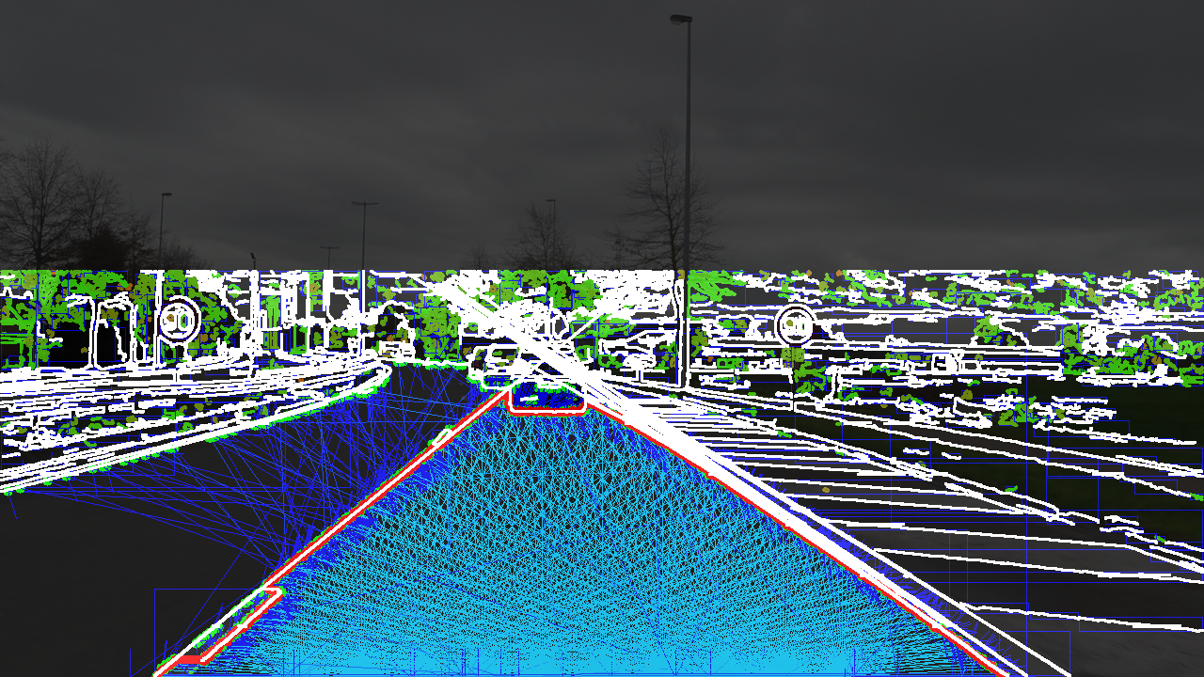
Lane detection – Hough assist
Problem:
Lane marks are dotted lines
Solution:
Hough lines to brige gaps
Without
With
Notes:
Problem:
Holes in road marks between lanes are large enough to let enough rays pass
Use Hough lines constrained to certain angle to bridge gaps

Slide 16
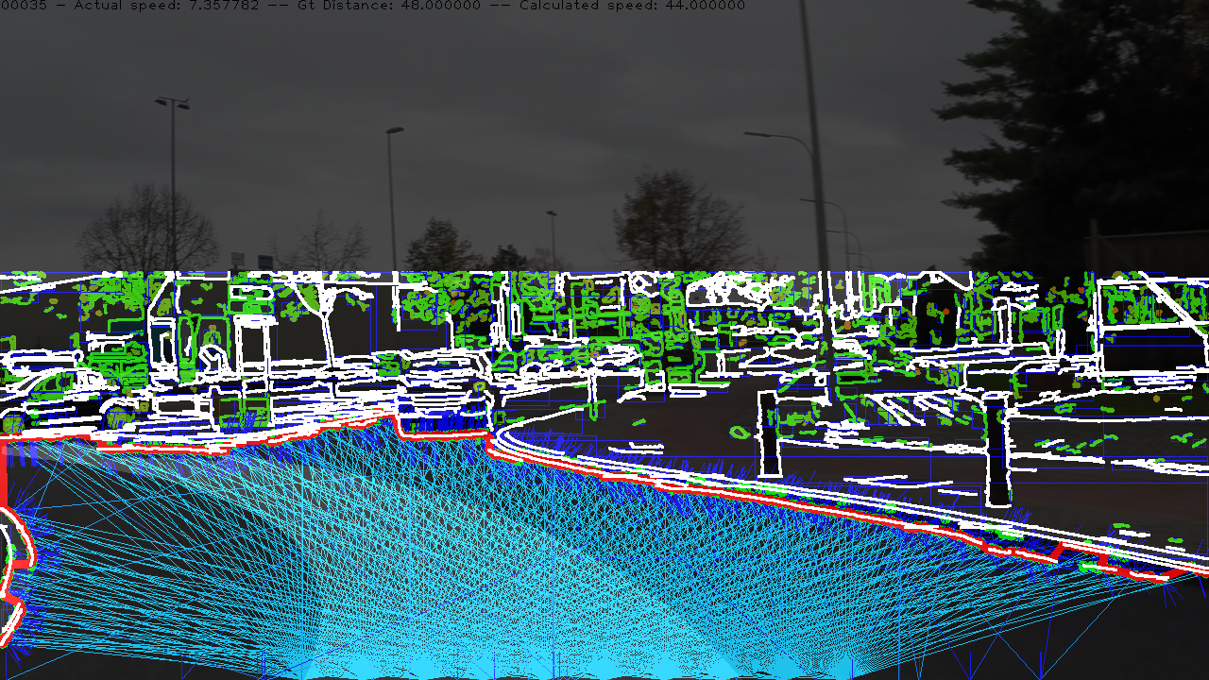
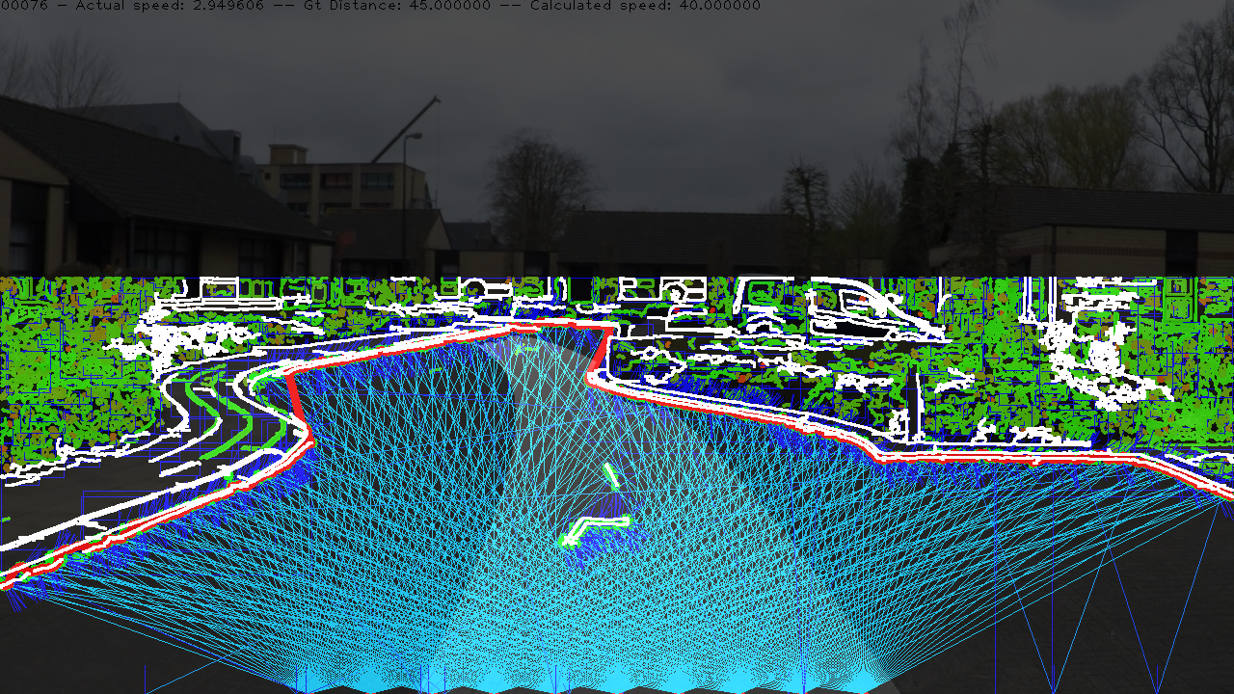
Lane detection

Slide 17
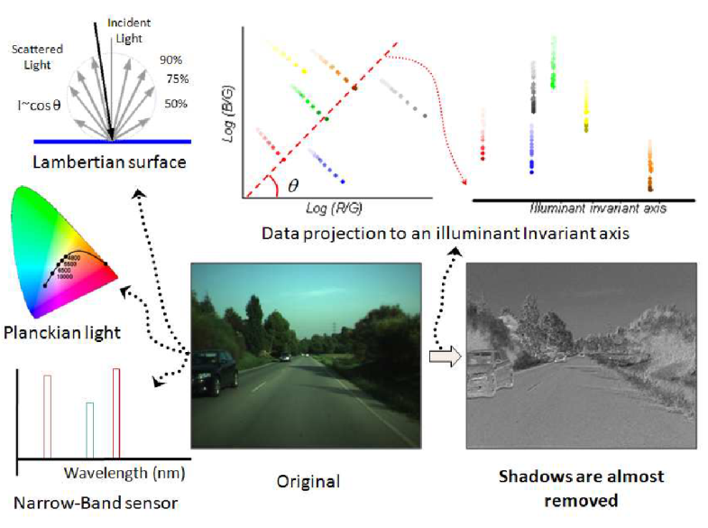
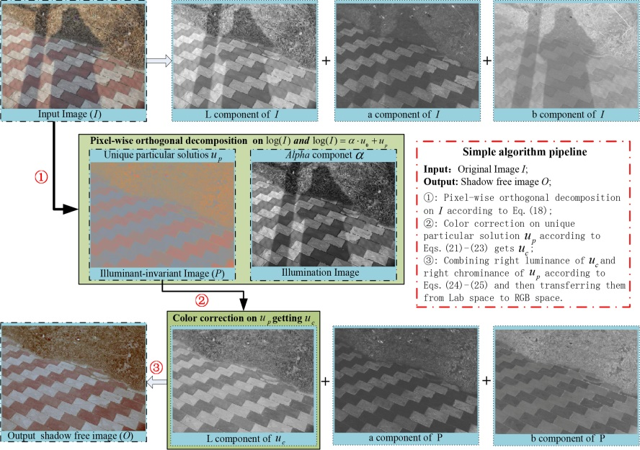
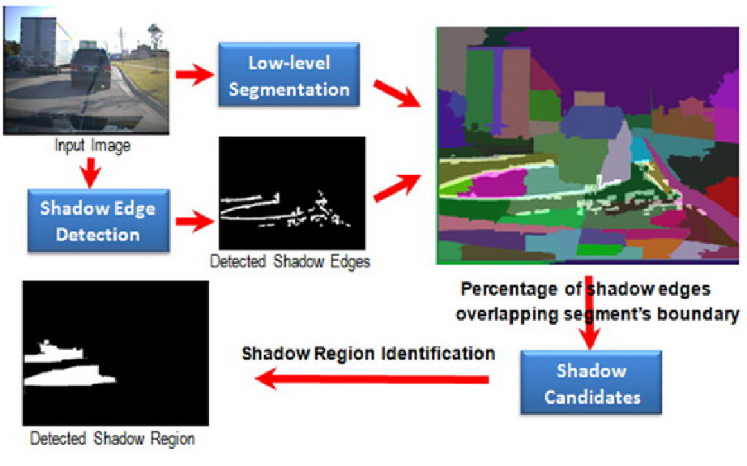
Lane detection - Shadows
Problem:
Shadows are well defined edges
Solution:
Apply shadow removal
Notes:
Shadows are still a problem
Apply shadow removal
Transform to Illuminant invariant space (Finlayson)
Per pixel => fast
Requires narrow band camera
Requires calibration or entropy minimization (Alvarez)
Pixel-wise orthogonal decomposition (Qu)
$\log\left(r+14\right)+\log\left(g+14\right)+β_{1} log⁡(b+14)$ is the same for shadow and non shadow areas
Reduces contrast too much => hard to detect edges
Strong shadow removal via patch based shadow edge detection (Wu) is probably more suited

Slide 18

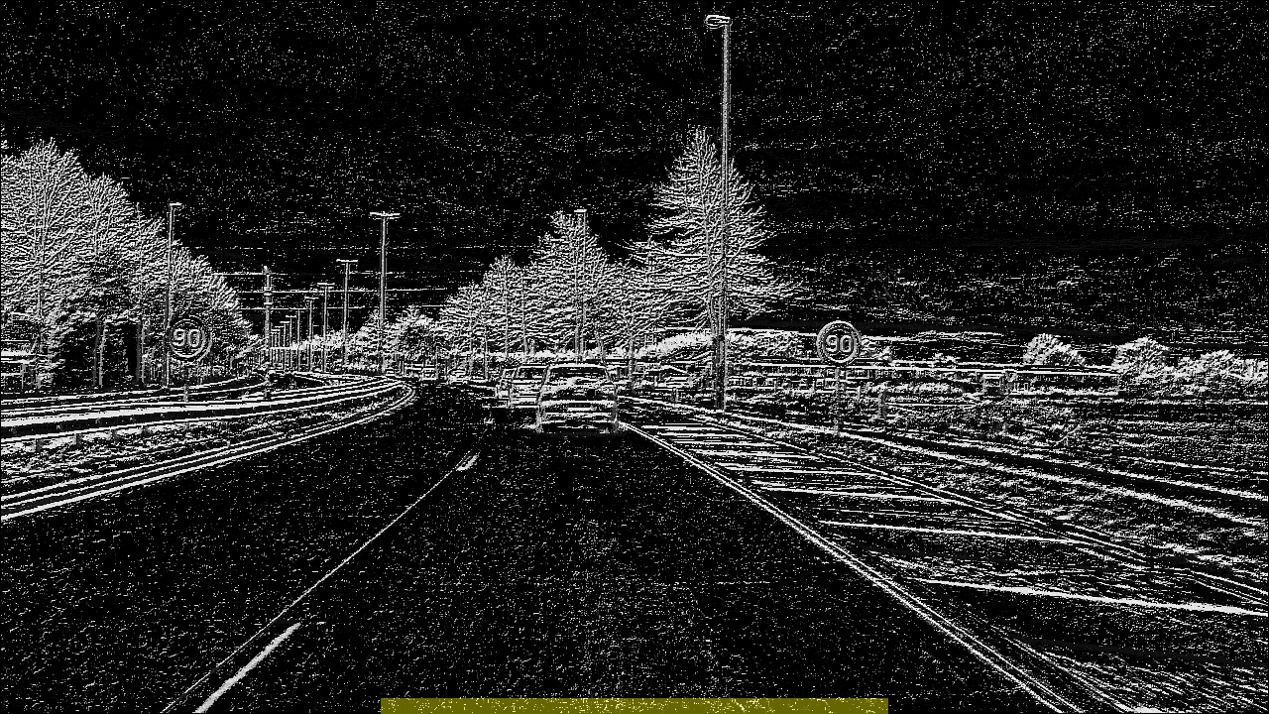

Texture detection
Texture is similar for road
Local binary patterns
Create patches
Compare histograms
Notes:
Texture is (mostly) the same for the entire road
Extract mask using local binary patterns
Create patches and compare histograms

Slide 19
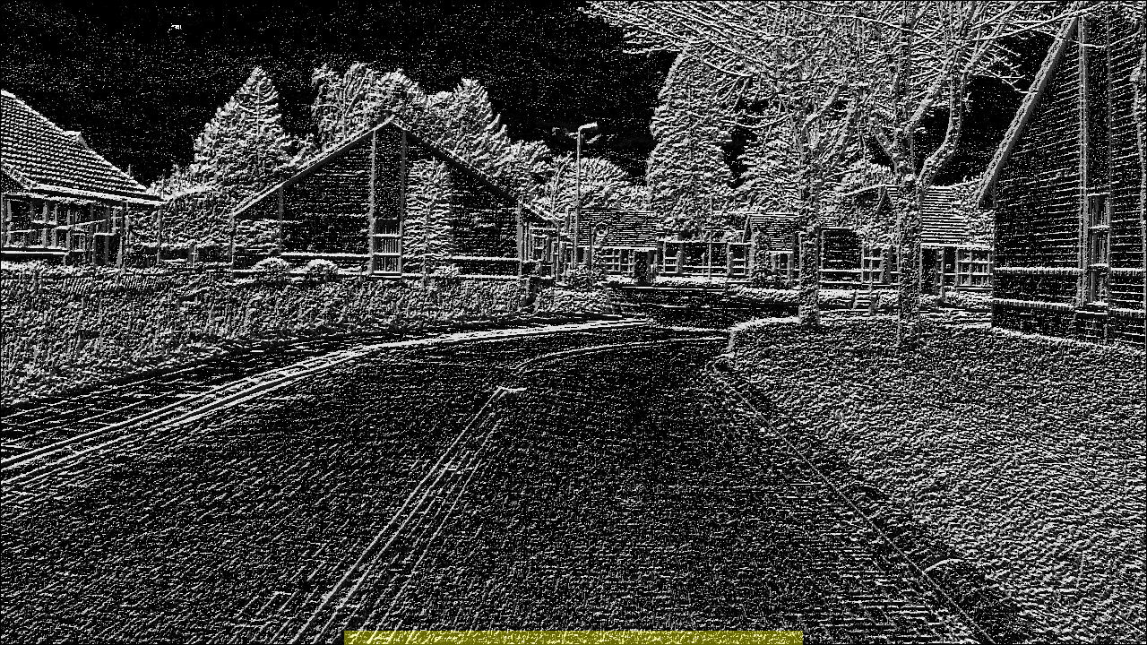
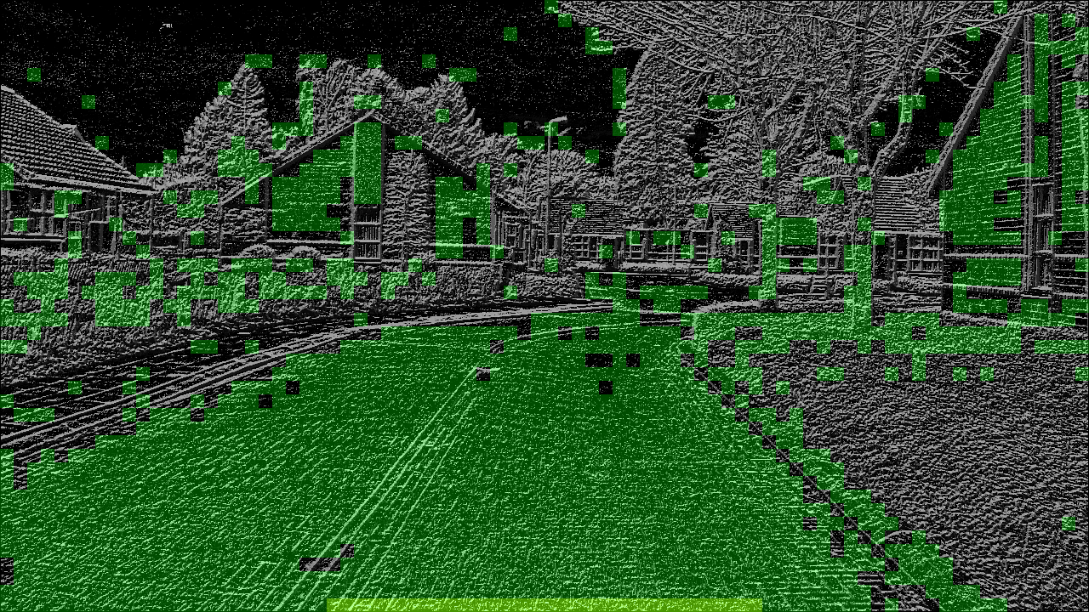
Texture detection
LPB codes
Divide image into patches
Compare histograms with bottom area
Notes:
Calculate LBP codes for each pixel
Divide the images in 16x16 patches
Construct a reference list from patches at the bottom of the image
Calculate histogram for each patch and compare to reference patches with Kullback-Leibler distance
The reference list can be retained over multiple frames to increase the accuracy and have a bigger variety of possible road patches.

Slide 20
Clustering detection
Road has low saturation and lightness
Group similar pixels together
→ Clustering
Notes:
Road has low saturation and lightness compared to the environment
Determine clusters that have similarity in both saturation and lightness
K-means clustering? How to choose k?
Mean shift? Too slow to start with 1280x720 centroids
→ Solution: combine them
Downscale image to keep performance hit low

Slide 21
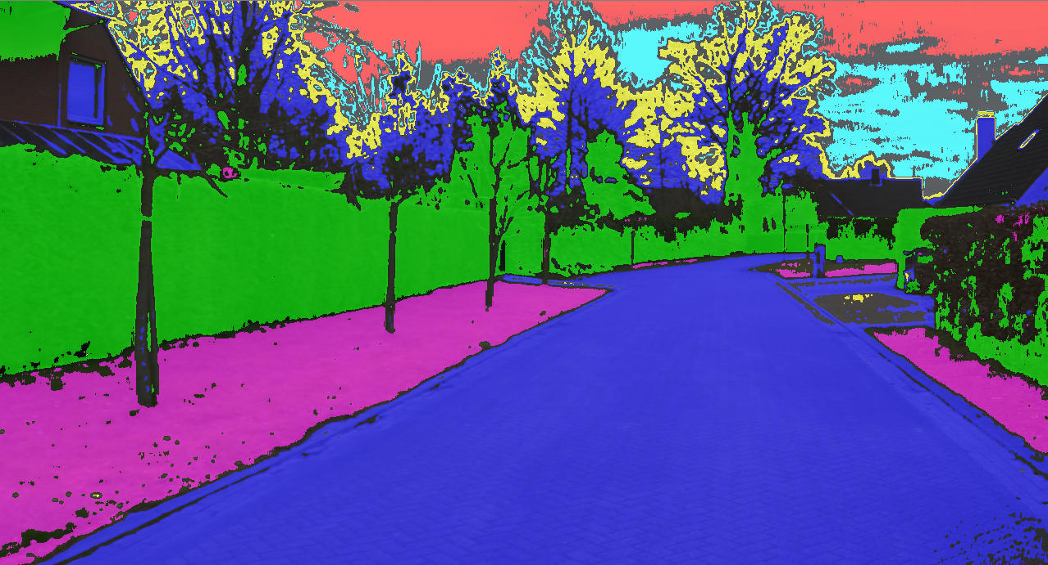
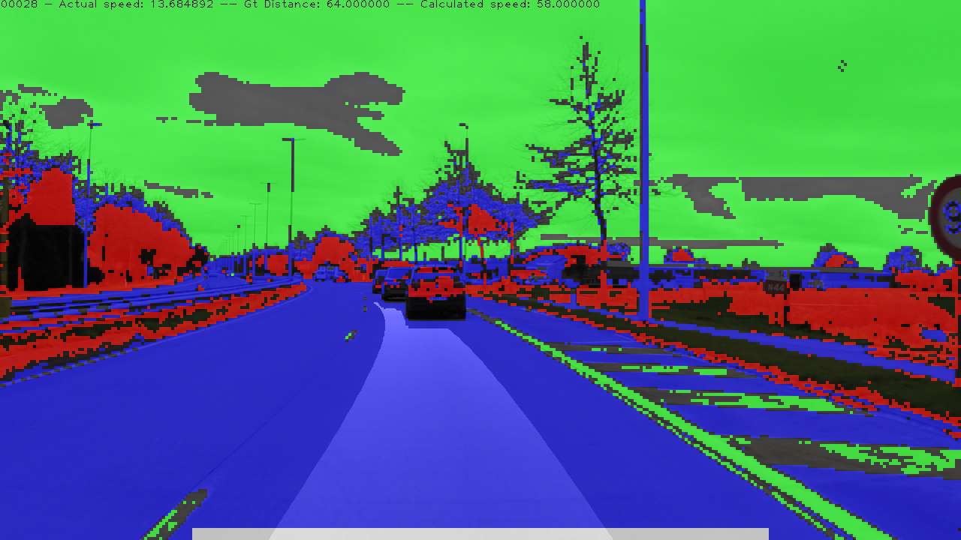
Clustering detection
K-means
Optimize with mean shift
Repeat until stable
Take top 3 clusters at bottom
Pixels from those clusters = road
Notes:
Get clusters using K-means
Optimize clusters with mean shift
Use fixed window radius
If multiple clusters overlap, merge clusters
Window radius ensure exlusion of outliers
Repeat until cluster count is stable
Determine top 3 occuring clusters in reference region at bottom of image
All pixels from those clusters are assumed to be road

Slide 22
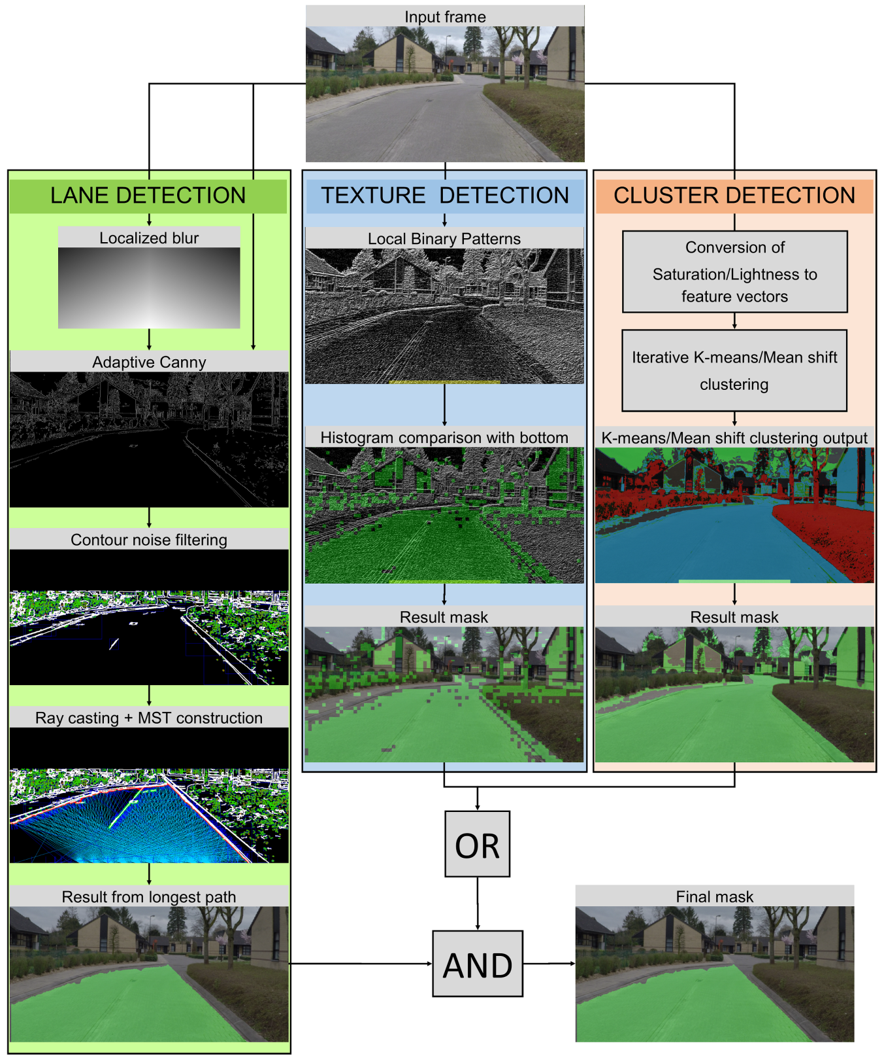
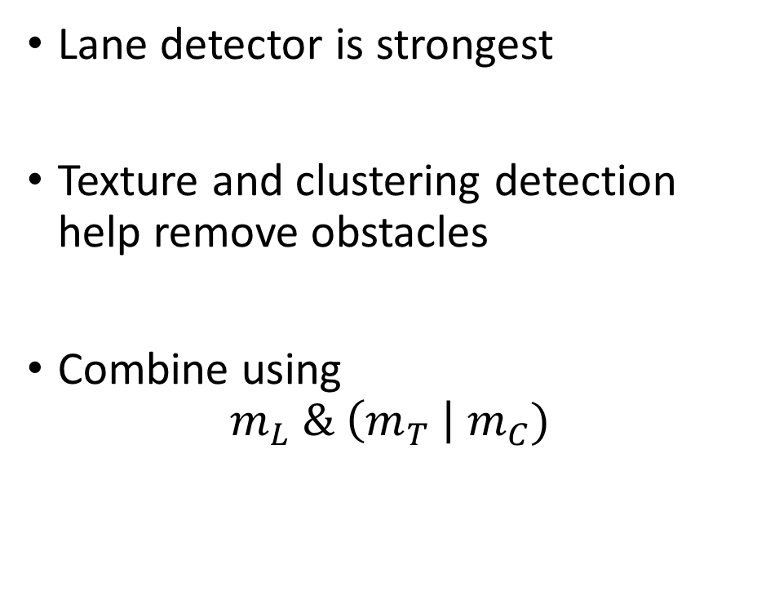
Combining masks
Lane detector is strongest
Texture and clustering detection help remove obstacles
Combine using
$$m_{L} \& \left(m_{T} \right| m_{C})$$
Notes:
Lane detector is strongest
Texture and clustering detection help remove obstacles
A pixel is classified as road when
Lane detector says it is ánd
Either texture or clustering detector say it is
The texture and clustering detection is combined with ‘OR’ because there are cases where the texture detection has a degraded result (for strongly changing road textures) and at other times the clustering detection has problems with a too big change of saturation or lightness on the road (while the texture detection could still classify it accurately). In other words both complement each other.

Slide 23
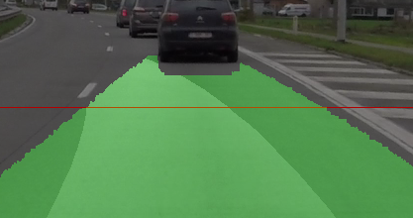
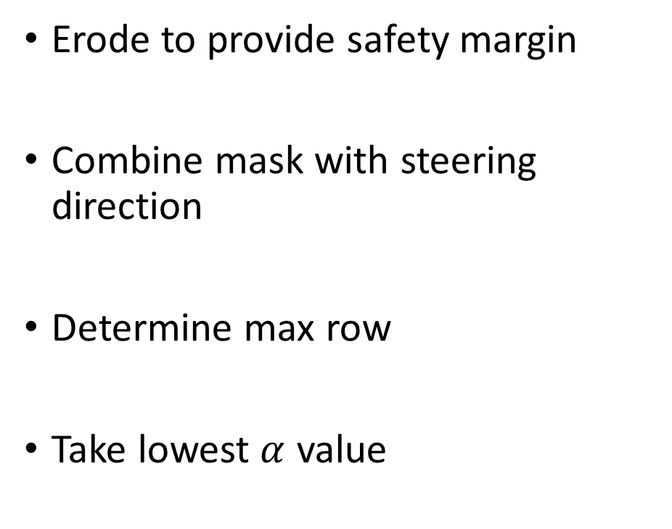
Calculating maximum speed
Erode to provide safety margin
Combine mask with steering direction
Determine max row
Take lowest $α$ value
Notes:
Erode from top downwards to provide margin of error
Combine mask with steering direction
Determine first non mask row in steering direction mask
Take lowest alpha value of steering direction mask at that row as maximum speed
The texture and clustering detection is combined with ‘OR’ because there are cases where the texture detection has a degraded result (for strongly changing road textures) and at other times the clustering detection has problems with a too big change of saturation or lightness on the road (while the texture detection could still classify it accurately). In other words both complement each other.

Slide 24
Results
Sets
01: Single lane, roundabout, cross marks
02: 2-lane road, well defined road marks, wet road
03: Single lane, deteriorated asphalt road, parked cars as obstacles
04: Residential area with paved roads, town center with narrow streets
Notes:
The mask is still calculated on a frame-by-frame basis, but due to the stability over multiple frames with only the occassional misdetection it’s possible to have a bigger accuracy by averaging multiple frames in sequence together.

Slide 25
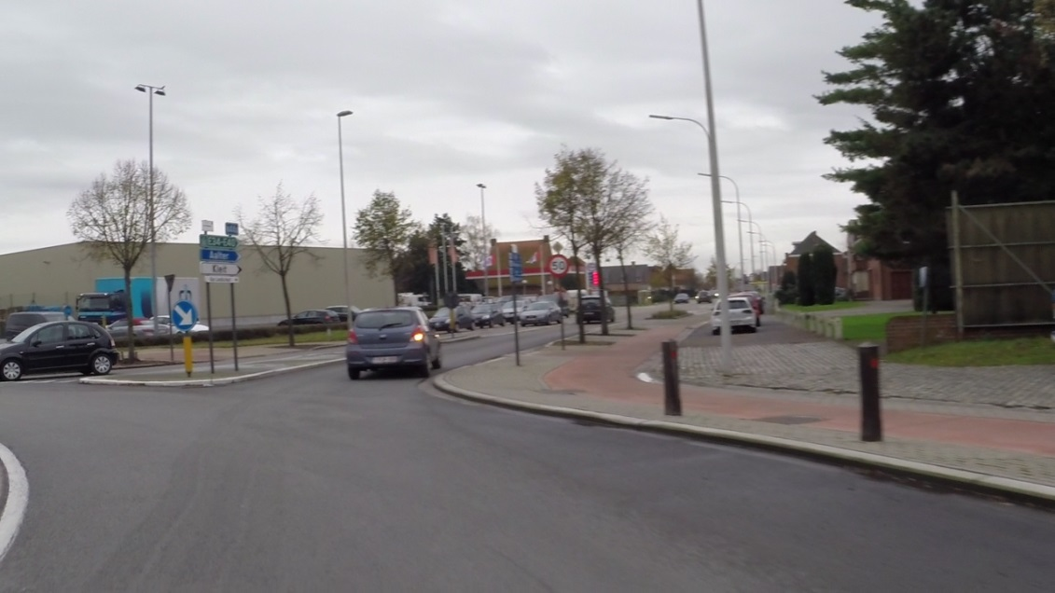
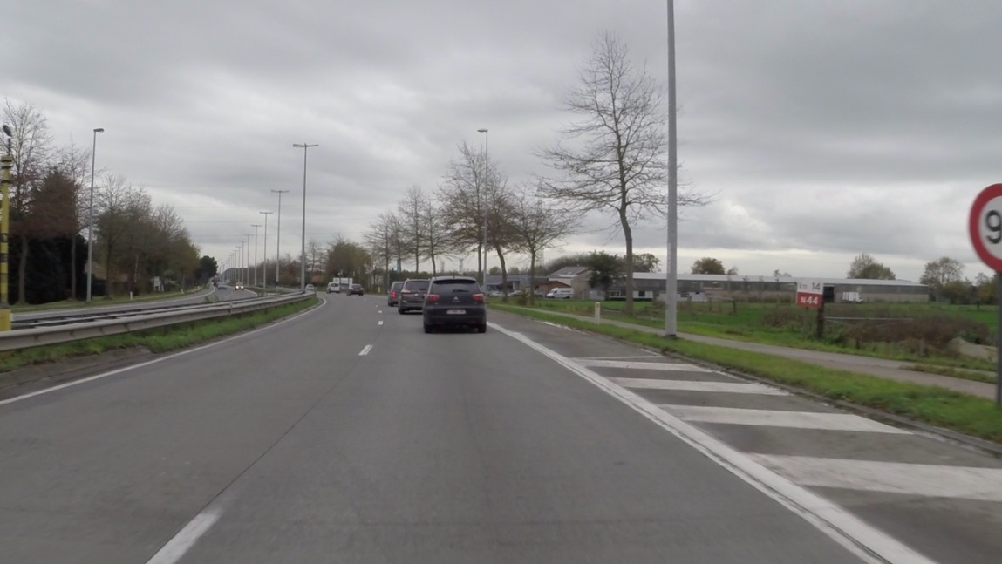
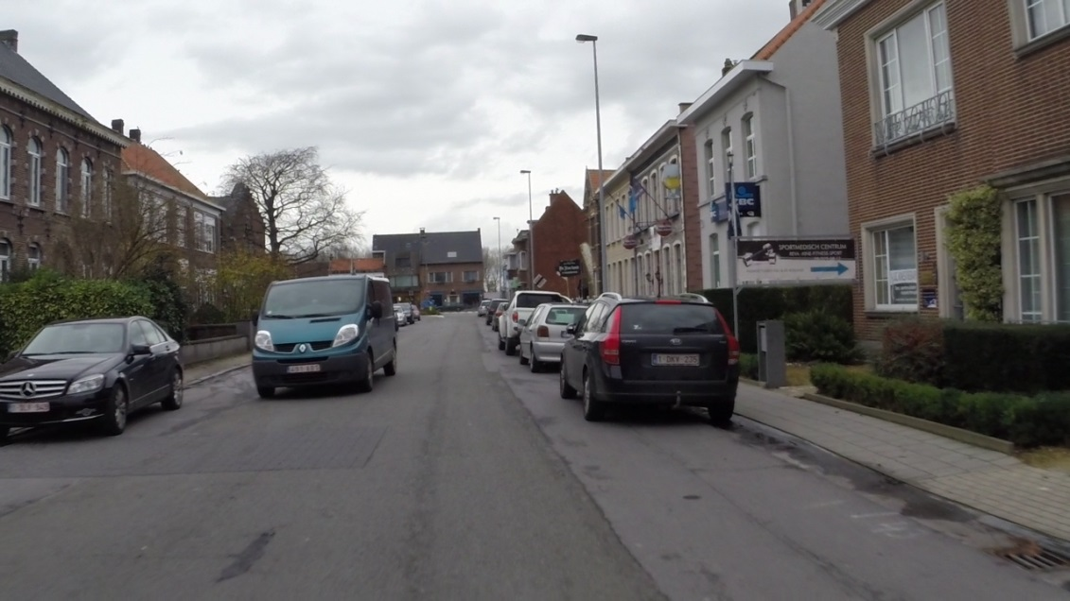
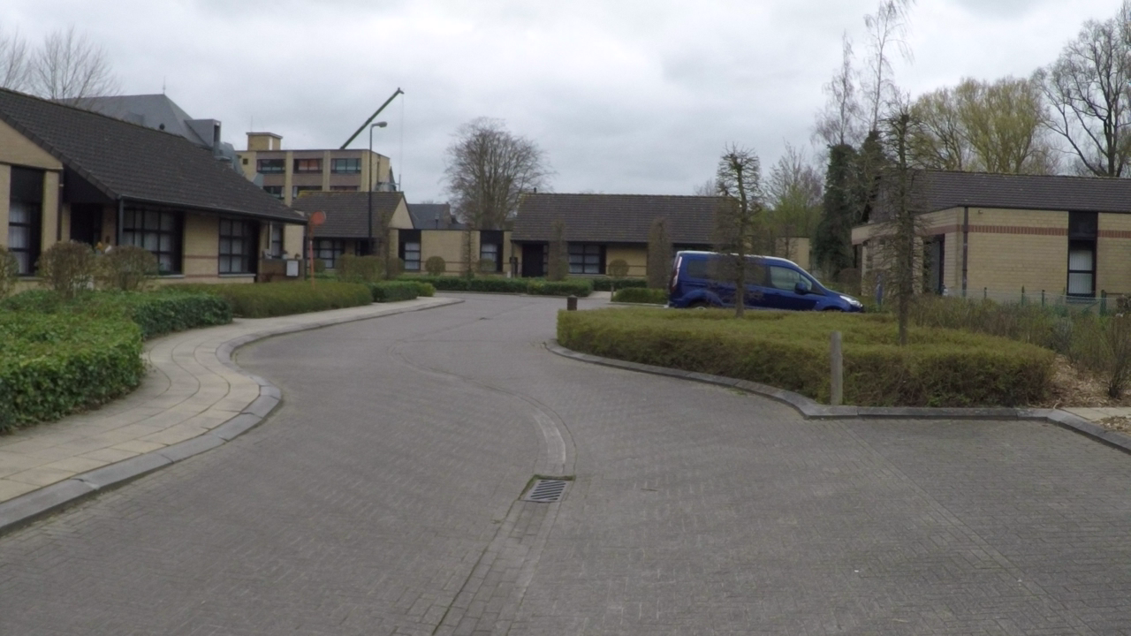
Results – Sets – Input frames
01
02
03
04

Slide 26
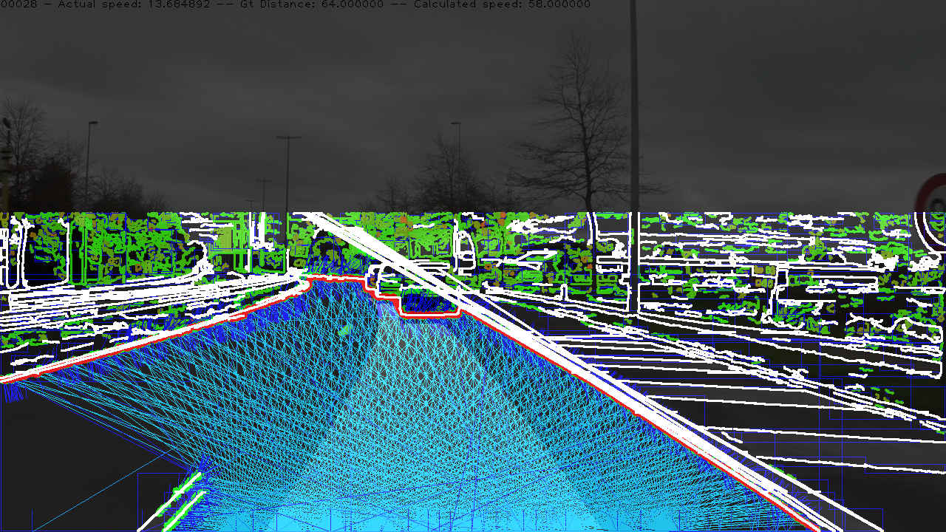
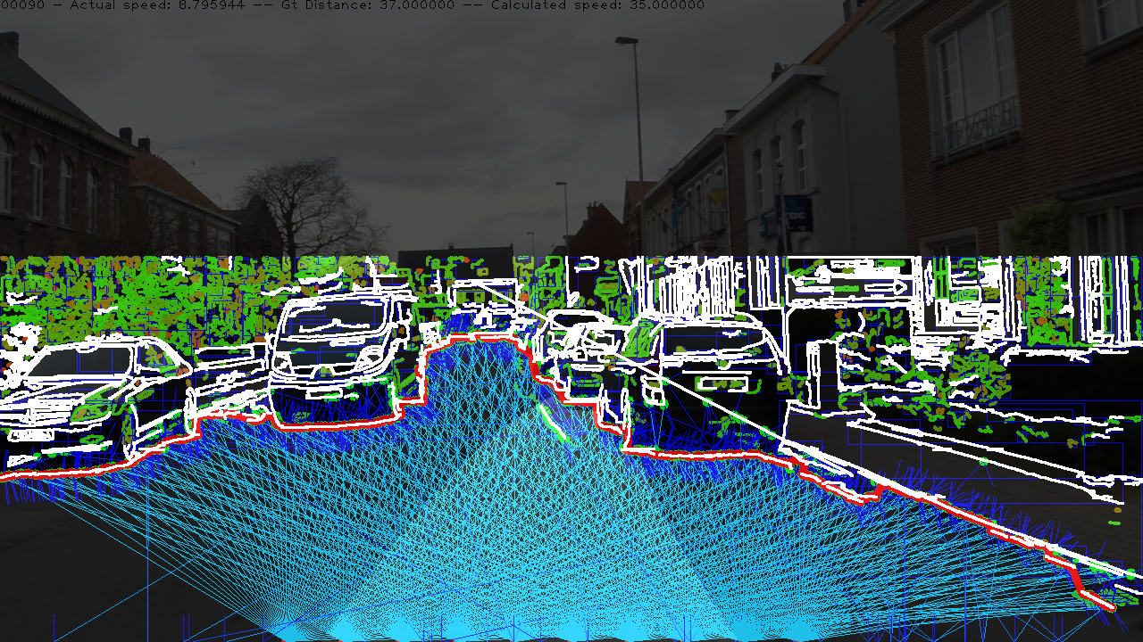
Results – Sets – Lane detection
01
02
03
04

Slide 27
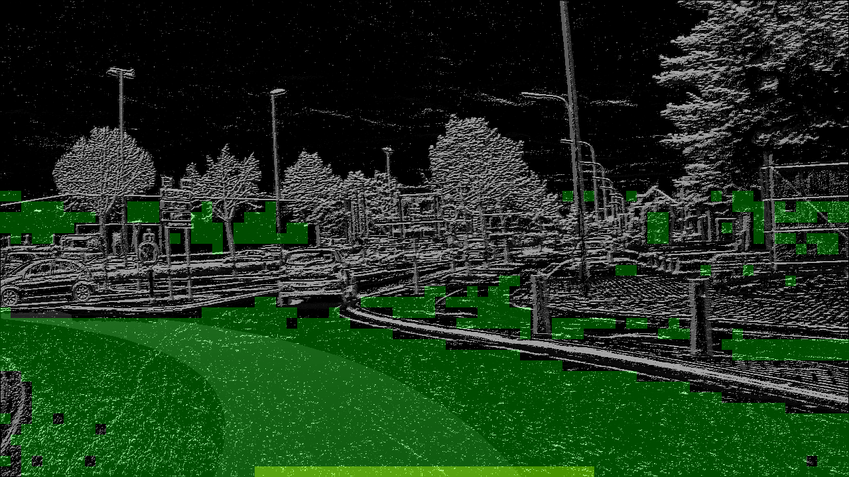
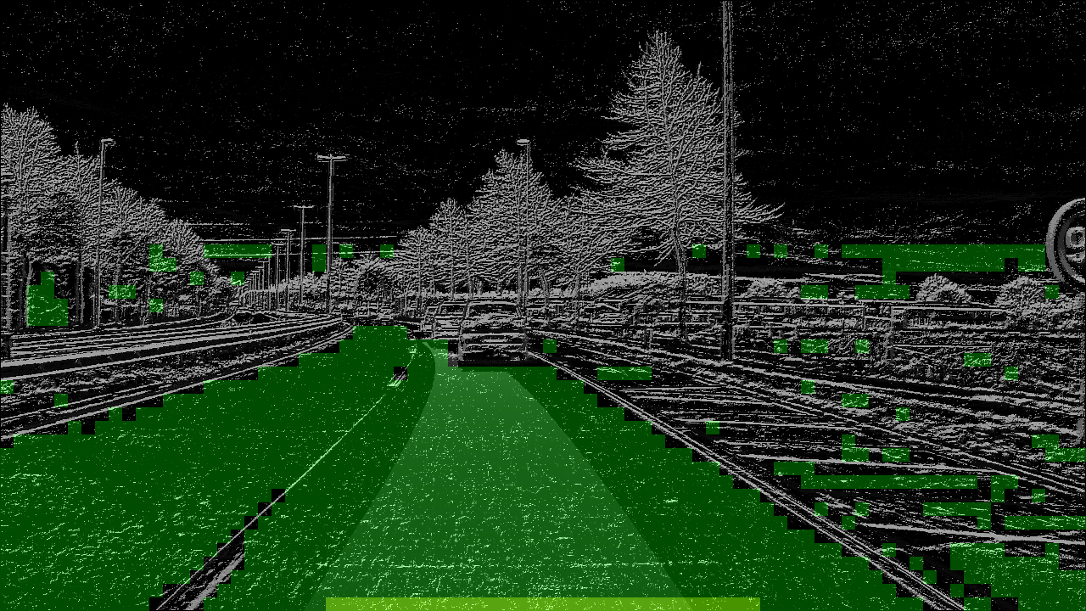
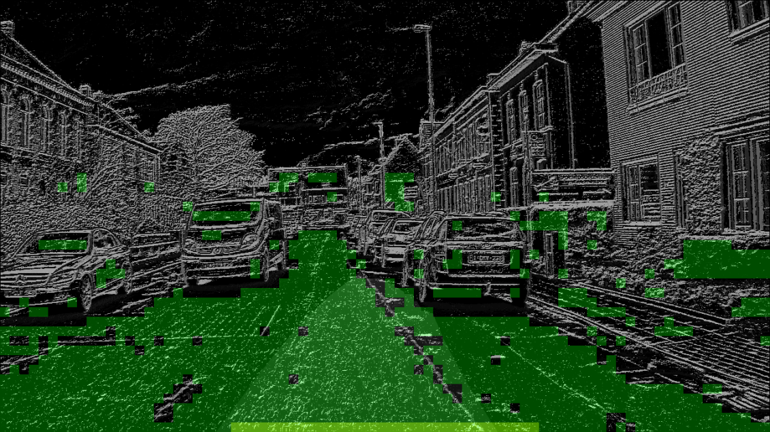
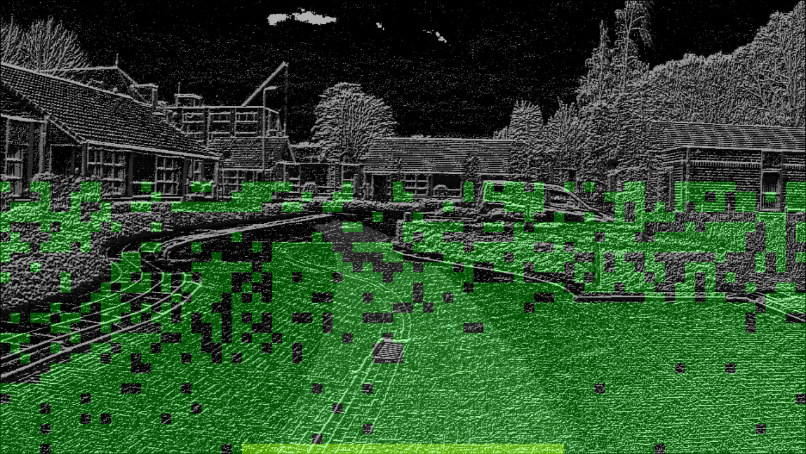
Results – Sets – Texture detection
01
02
03
04
Notes:
All four images are taken with the same settings. As you can see the settings on set 04, where the road is much more textured, perform worse as on the other sets.

Slide 28
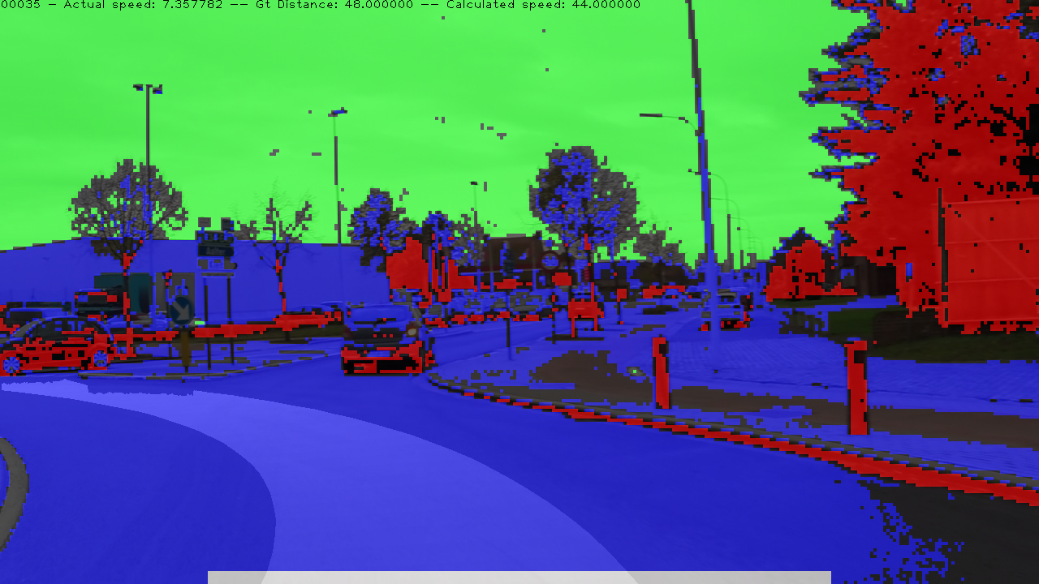
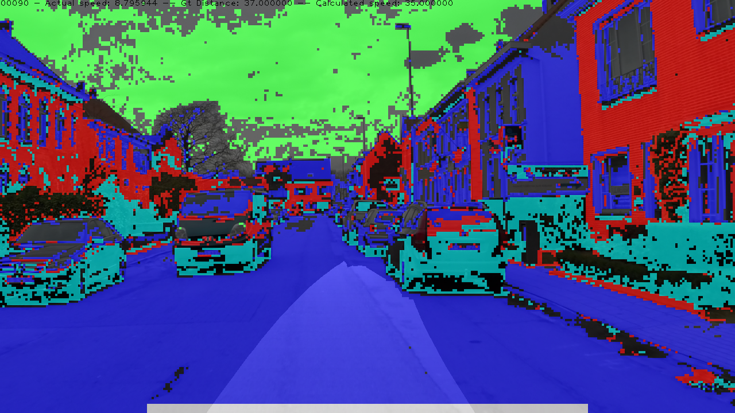
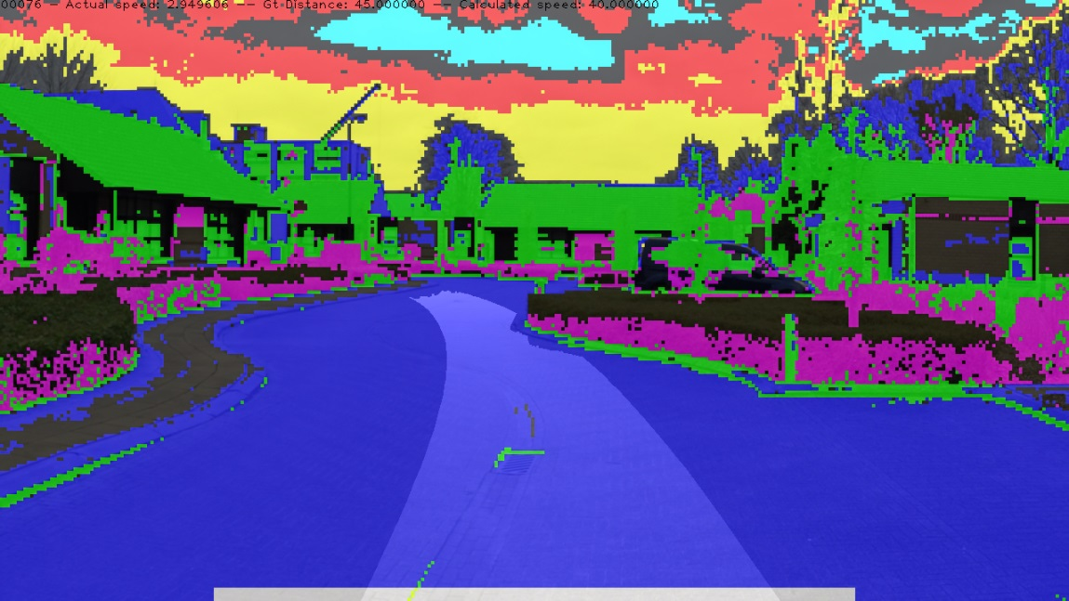
Results – Sets – Clustering detection
01
02
03
04
Notes:
But where as the texture detection failed to give an accurate result on set 04, the clustering detection can accurately cut out the road. There are still regions of non road clustered as road, which highlights the importance of the lane detection to cut those away.

Slide 29




Results – Sets – Final mask
01
02
03
04

Slide 30


Results – Sets
Calculating performance
Ground truth every 5 frames
126 ground truth frames
Notes:
Ground truths are taken every 5 frames to cover all scenarios as much as possible from the different sets. This gives us a better performance indication than just selecting frames at random

Slide 31
Results – Sets
Canny threshold 100
Canny threshold 50
Set | TPR% | FPR% | F1-Score | Average time (ms)
01 | 60.01 | 1.05 | 0.7362 | 319
02 | 88.83 | 5.93 | 0.9260 | 305
03 | 74.17 | 9.30 | 0.8380 | 282
04 | 69.92 | 5.18 | 0.8182 | 266
Set | TPR% | FPR% | F1-Score | Average time (ms)
01 | 59.49 | 0.07 | 0.7451 | 335
02 | 88.04 | 0.07 | 0.9346 | 317
03 | 70.07 | 7.41 | 0.8132 | 303
04 | 56.39 | 0.23 | 0.7193 | 314
Notes:
Decreasing the Canny threshold reduces the false positive rate significantly at the cost of the true positive rate and a slightly higher computational time.
As expected the threshold has a significant impact on set 04 with the strongly textured road, the noise suppression does not work well on edges that are similar to road boundaries
In set 02 the decrease improves the FPR due to a better detection without compromising the TPR too much. The noise suppression does its job well here.

Slide 32
Results
Video recording
Lumia 630 Phone camera
Lower contrast than sets, rain conditions, shaking camera
Goal: determine algorithm stability
Notes:
The mask is still calculated on a frame-by-frame basis, but due to the stability over multiple frames with only the occassional misdetection it’s possible to have a bigger accuracy by averaging multiple frames in sequence together.

Slide 33
Results – Video
Sample 1:
2-lane road (R4) with light rain
Well defined road marks
Output of all 3 detectors
Sample 2:
Countryside road without road marks
Highly textured paved without well defined boundaries
Sample 3:
Difference between fixed Canny threshold and adaptive with noise suppression
Notes:
Full HD sample videos can be downloaded from: http://bit.ly/1Uqwpsz (https://mega.nz/#F!QQZTTZiJ!mIk4mgQfnxDZhLNUu-IHLQ)
The first sample shows the 3 different classifiers and the final mask. A fixed Canny threshold is used which causes some problems but is otherwise able to accurately detect the road boundaries.
The second sample shows that without lane markings the detection still works, even with a more textured road but has more problems in certain frames to keep the mask to the boundaries. Cars are however nicely cut out.
The last sample shows the difference in performance between a fixed Canny threshold and the adaptive Canny threshold with noise suppression. The resulting mask is much more stable.

Slide 34

Road detection from a simple 2D Camera
Project plan
Solution - classifier
Model 1 – Support Vector Machines
Model 2 – Lane detection, texture and clustering classifier
Model comparison
Lane detection, texture and clustering classifier model
Lane detection
Texture classifier
Clustering
Model
Results

